Slide 1
Wearable Computing Systems eyeDrops
Lab Course 2016 / 2017
Marlene Fiedler
Lorenz Miething
Benjamin Thiemann
Albert-Ludwigs-Universität Freiburg
Notes:
Begrüßung
Name
Thema

Slide 2
Contents
Eye blink detection – proof of concept
Components
Clip design
Printed circuit board
Blurry screen
Project plan

Slide 3
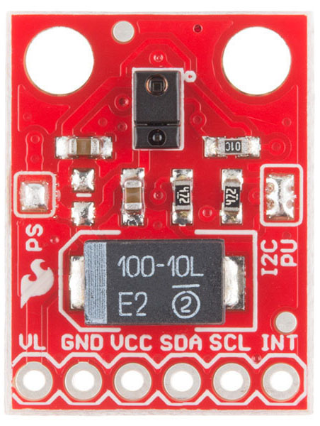
Eye blink detection – Sensors
Ambient light sensor
APDS 9600 RGB ambient light and gesture sensor
First success but slow and not robust (active)
https://cdn.sparkfun.com//assets/parts/9/6/0/3/12787-02.jpg

Slide 4
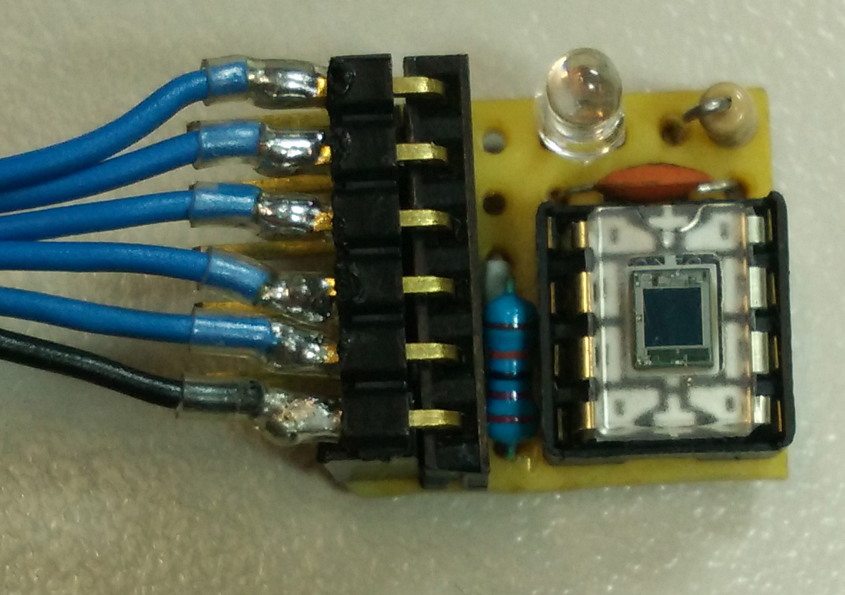
Eye blink detection – Sensors
Ambient light sensor
APDS 9600 RGB ambient light and gesture sensor
Self built alternative using photodiode and analogue signal
Very fast but not robust (passive)

Slide 5
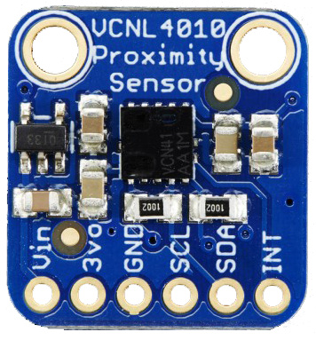
Eye blink detection – Sensors
Ambient light sensor
APDS 9600 RGB ambient light and gesture sensor
Self built alternative using photodiode and analogue signal
Proximity sensor
VCNL 4010 ambient light and proximity sensor (active)
Fast enough and robust
https://cdn-shop.adafruit.com/1200x900/466-05.jpg

Slide 6
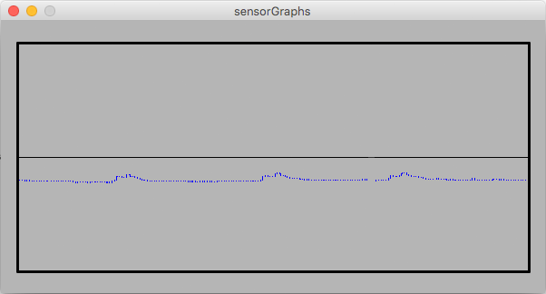
Eye blink detection – Software
Capture record and visualize data using Processing

Slide 7
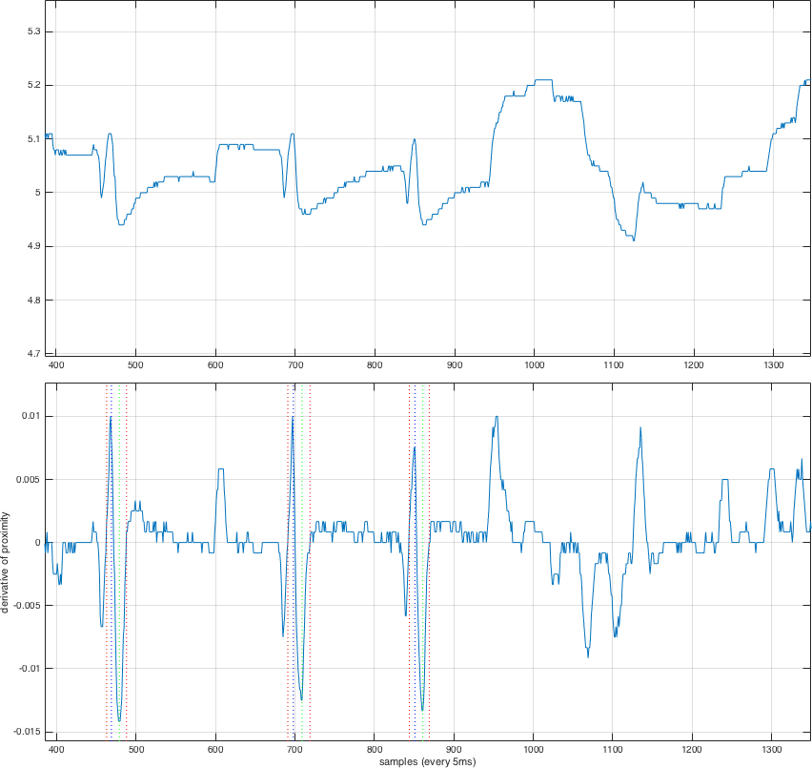
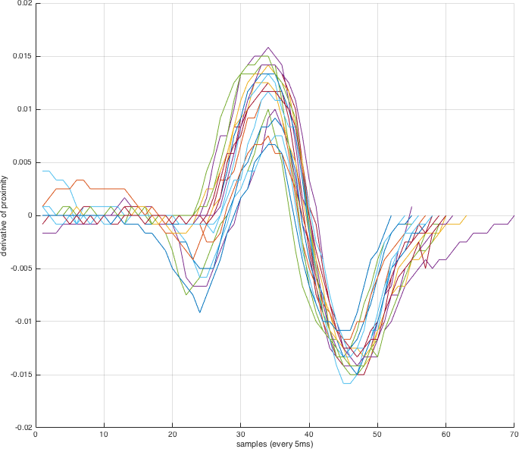
Eye blink detection – Software
Capture and visualize data using Processing
Analyse and develop algorithm using MATLAB

Slide 8
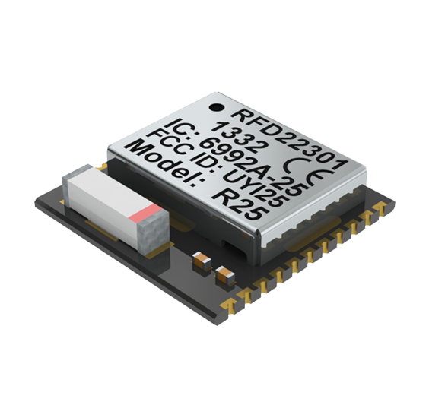
Components
RFDuino
Arduino compatible microcontroller
Bluetooth low energy RF module
http://www.rfduino.com/wp-content/uploads/2014/03/RFD22301.Prospective.Top_.png
Notes:
Arduino compatible Microcontroller
With a bluetooth low energy RF module
We use SMD version
ADC
Interfaces: I²C, UART, SPI, GPIO
Wireless communication with iOS and android smartphones

Slide 9
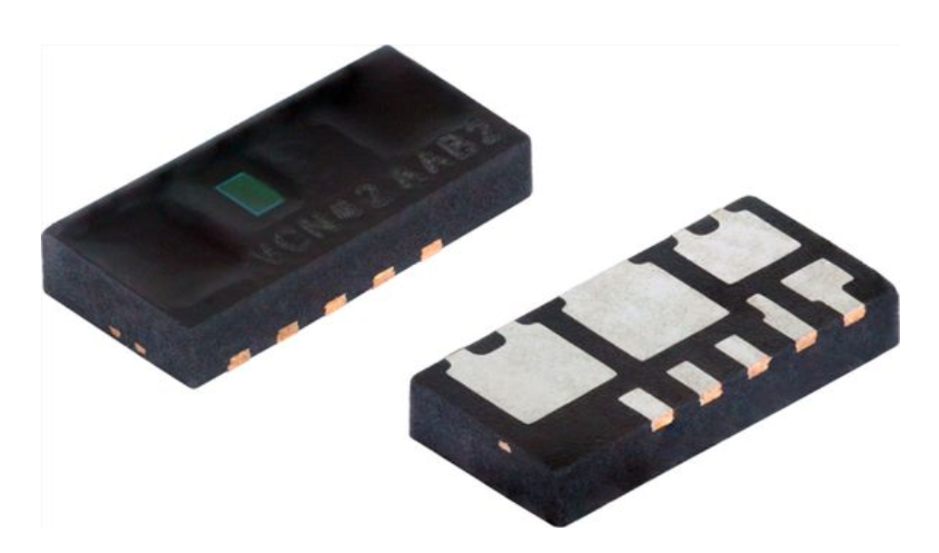
Components
RFDuino
Arduino compatible microcontroller
Bluetooth low energy RF module
VCNL4020
Ambient light sensor
Proximity sensor
Interrupt function
http://www.vishay.com/docs/83476/vcnl4020.pdf
Notes:
I²C
Ambient light not used right now, maybe later

Slide 10
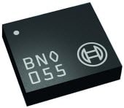
Components
RFDuino
Arduino compatible microcontroller
Bluetooth low energy RF module
VCNL4020
Ambient light sensor
Proximity sensor
Interrupt function
BNO055
Absolute orientation sensor
http://www.mouser.com/images/microsites/Bosch_BNO055.jpg
Notes:
optional
Gyroscope, accelerometer, geomagnetic sensor
I²C, UART

Slide 11

Assembly on glasses
Notes:
Gyroscope, accelerometer, geomagnetic sensor
I²C, UART

Slide 12
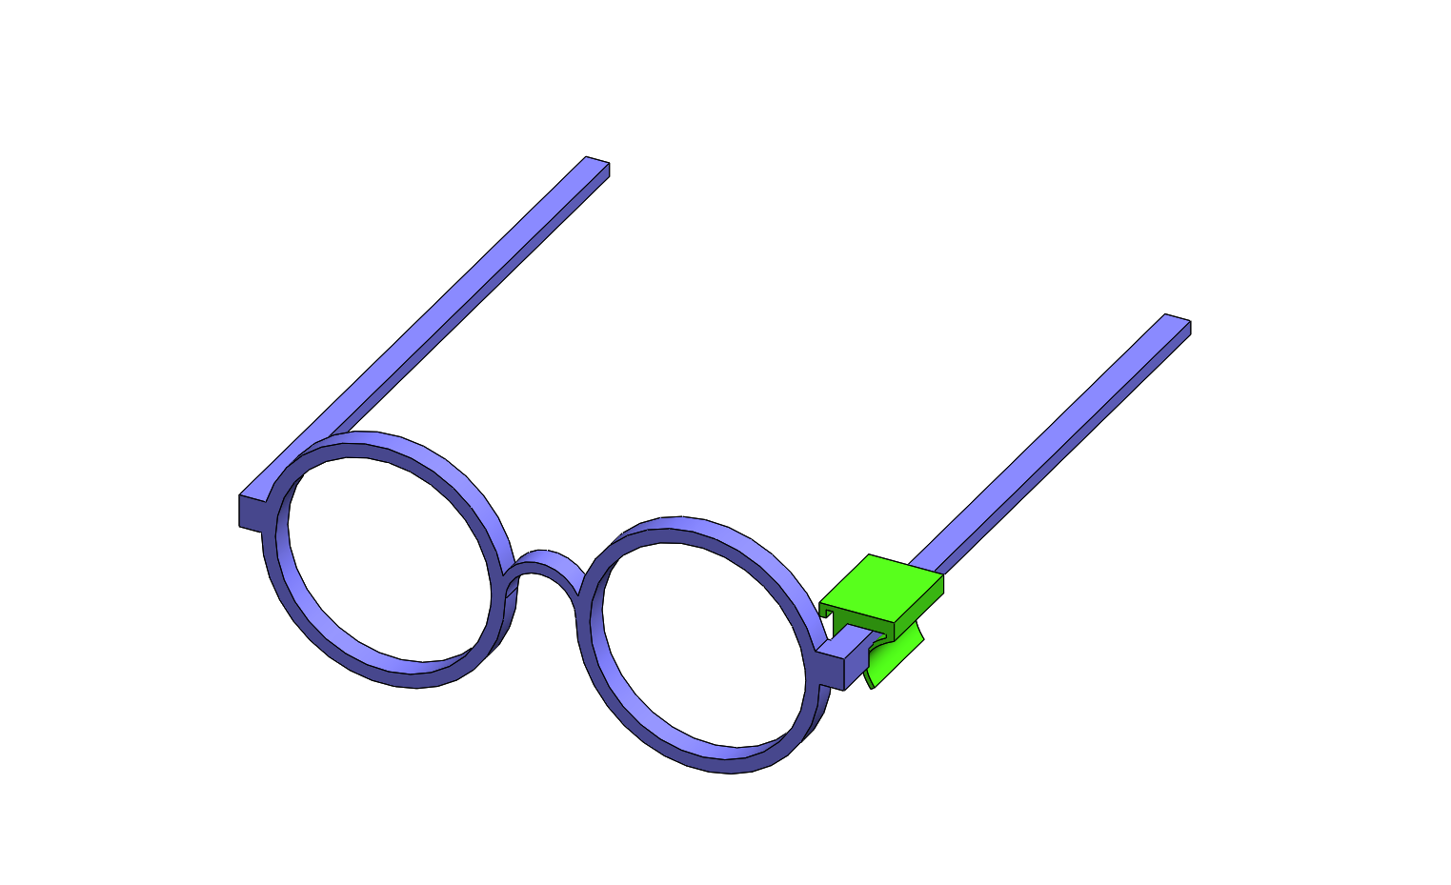
Assembly on glasses
Notes:
Gyroscope, accelerometer, geomagnetic sensor
I²C, UART

Slide 13
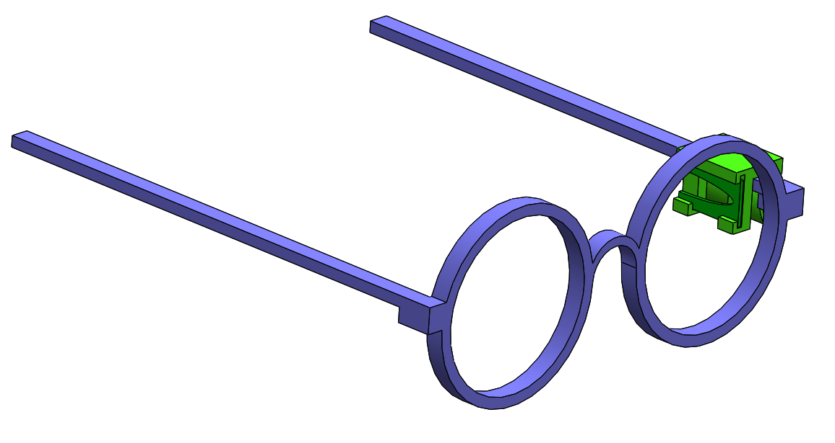
Assembly on glasses
Notes:
Gyroscope, accelerometer, geomagnetic sensor
I²C, UART

Slide 14

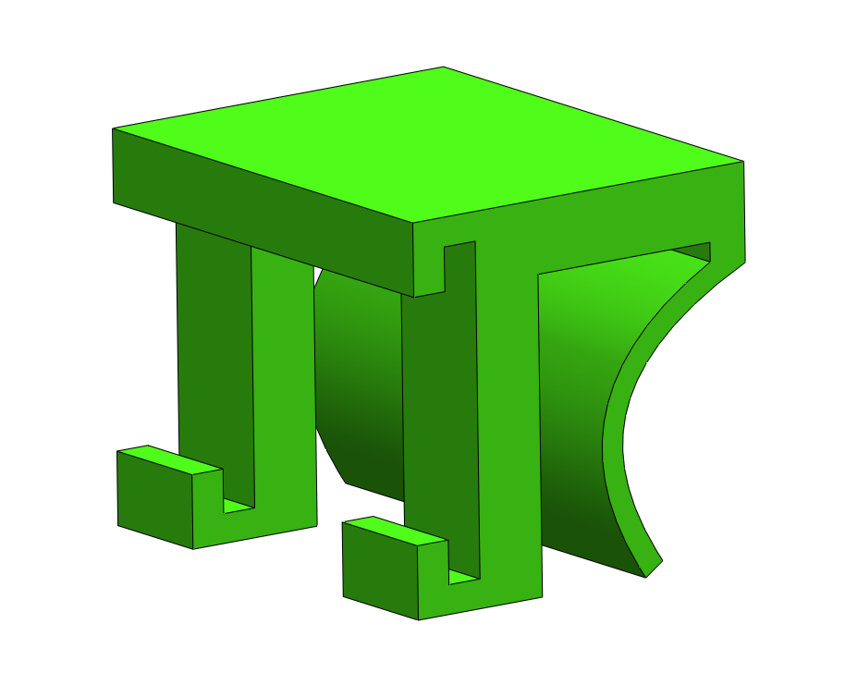
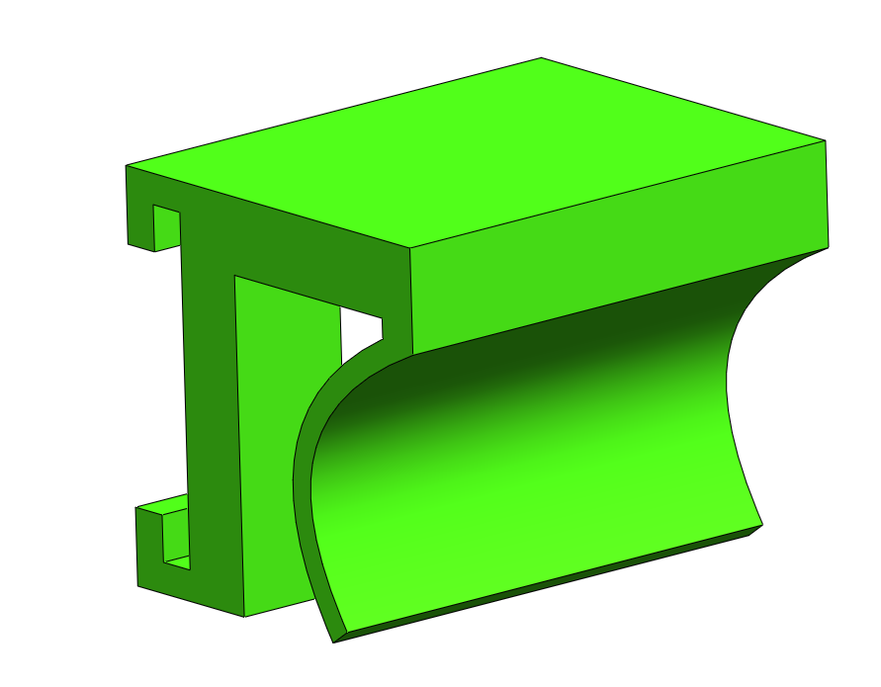
Clip
Notes:
Gyroscope, accelerometer, geomagnetic sensor
I²C, UART

Slide 15
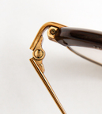
Clip
www.anz-verlag.de
Notes:
Gyroscope, accelerometer, geomagnetic sensor
I²C, UART

Slide 16
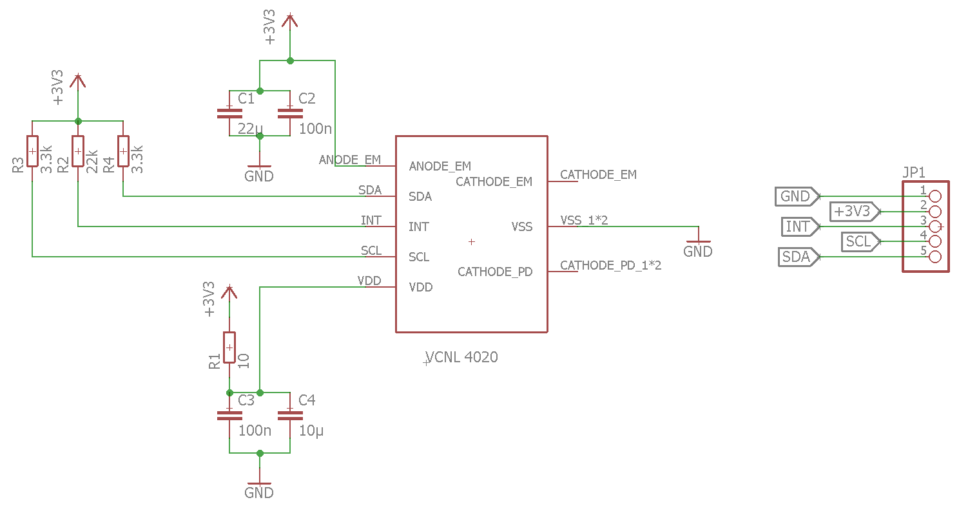
PCB for VCNL4020

Slide 17
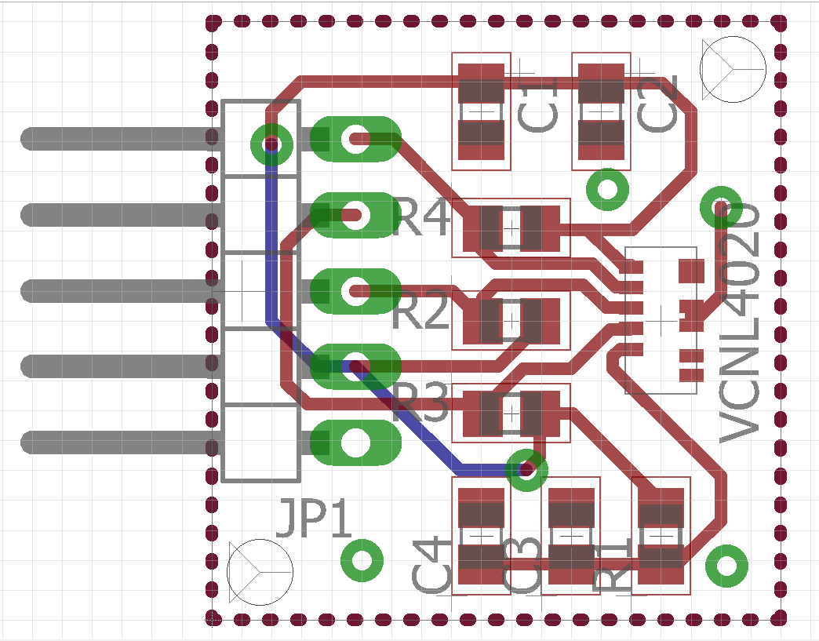
PCB for VCNL4020

Slide 18
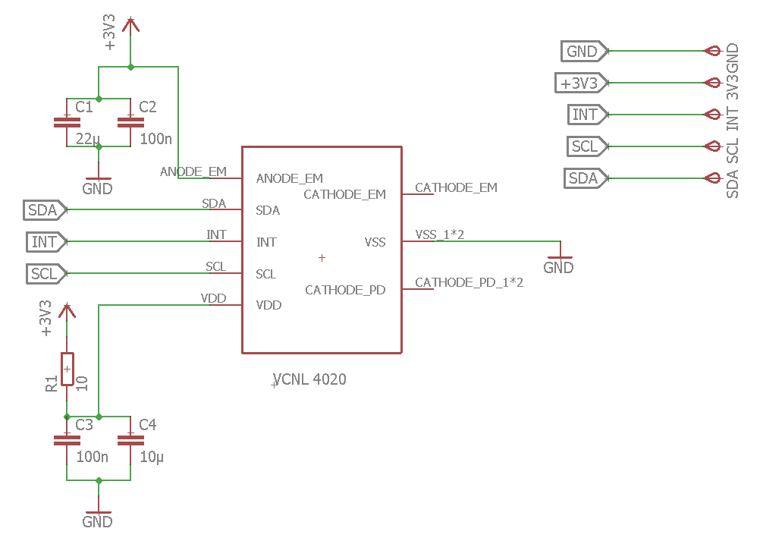
PCB for VCNL4020 – smaller

Slide 19
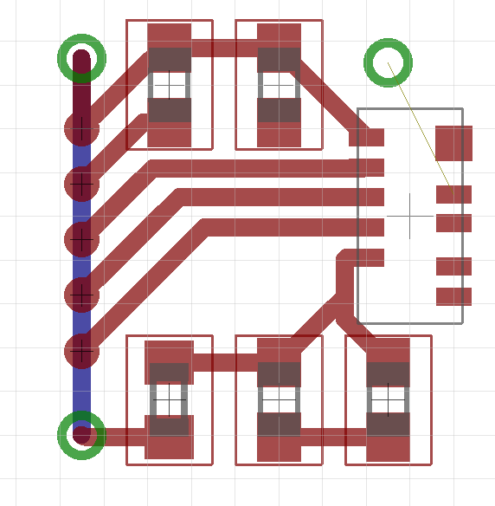
PCB for VCNL4020 – smaller

Slide 20
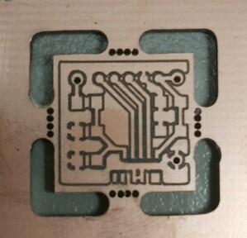
PCB for VCNL4020

Slide 21
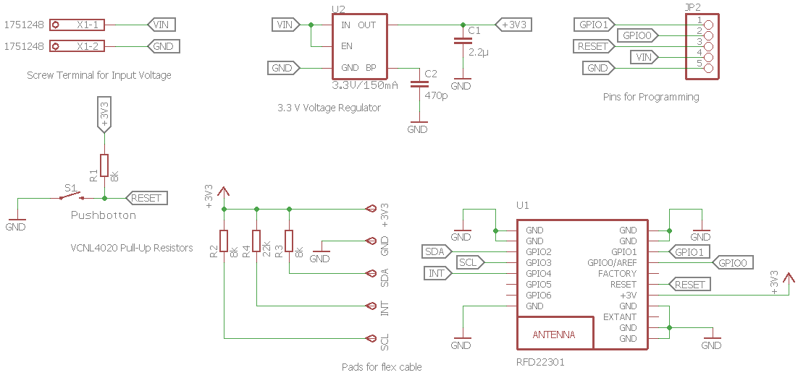
PCB for RFDuino

Slide 22
Blurry screen
First trial: platform independent (Java, Python)
Second trial: only Mac OS X (Objective-C)
Uses CoreGraphics framework
Menubar application
Platform independent application will control the blurring
Version for Linux and/or Windows if we have time

Slide 23
Blurry screen
DEMO

Slide 24
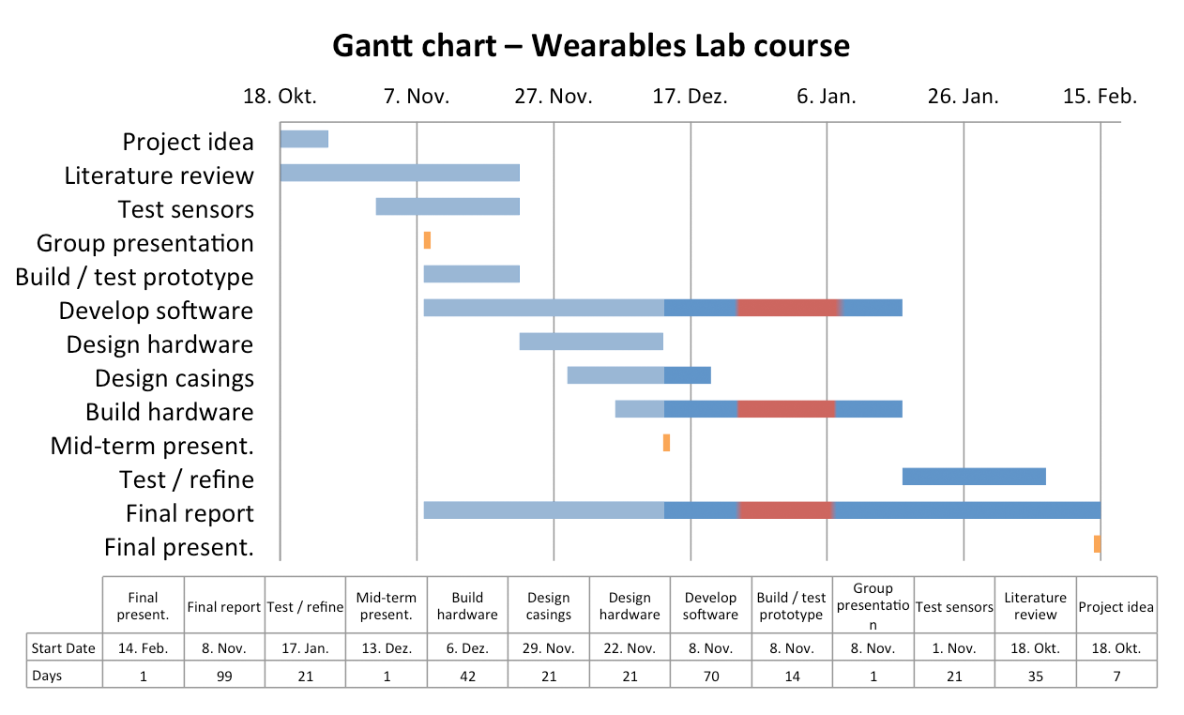
Project plan

Slide 25
Eye blink detection
DEMO

Slide 26
Thank you for your attention!

Slide 27
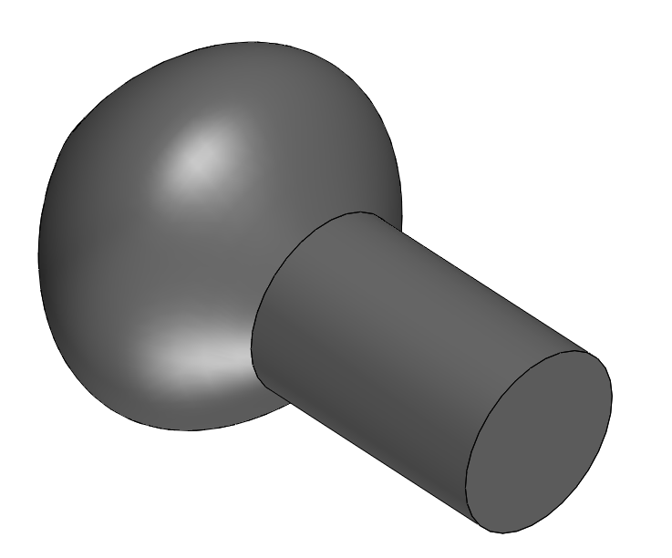
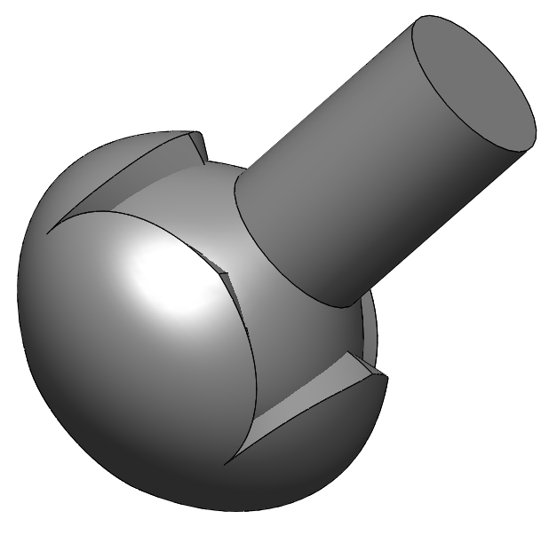
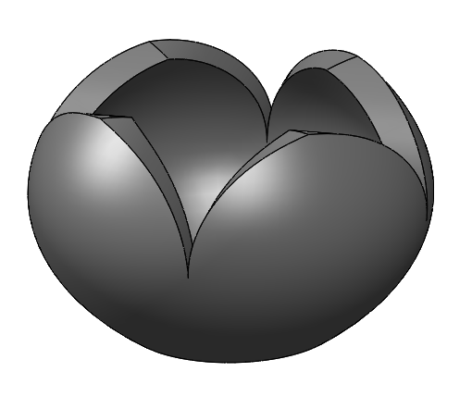
Ball Joint
Notes:
Gyroscope, accelerometer, geomagnetic sensor
I²C, UART

